Slide 1
Secure data hiding in image using steganography
CAPSTONE PROJECT
Presented By: Bhatt Jaymeenbhai Shaileshbhai
Student Name : Bhatt Jaymeenbhai Shaileshbhai
College Name & Department : Rai School of Engineering, Rai University B.Sc IT

Slide 2
OUTLINE
Problem Statement
Technology used
Wow factor
End users
Result
Conclusion
Git-hub Link
Future scope

Slide 3
Problem Statement
In today's digital age, securing sensitive information during transmission is critical. Traditional encryption methods are often complex and detectable. Steganography offers a solution by hiding data within images, making it invisible to unauthorized users. This project aims to develop a secure steganography system that embeds secret messages into images and retrieves them using a password, ensuring both confidentiality and integrity.

Slide 4
Technology used
This project is based on python programming language and It has used “cv2” and “os” libraries.i have used python IDLE .

Slide 5
Wow factors
I have separated encryption and decryption part so we can use it seperatly and also I had added one of password file in txt format that so can it decrypte easily.

Slide 6
End users
Individuals: People who want to securely share confidential messages (e.g., personal photos, sensitive information) without detection.
Business Professionals: Employees or organizations needing to transmit sensitive data (e.g., contracts, financial details) securely.
Journalists and Activists: Those who need to communicate privately and avoid surveillance or censorship.
Government Agencies: Entities requiring secure communication for classified or sensitive operations.
Students and Researchers: Individuals exploring steganography for academic or experimental purposes.

Slide 7
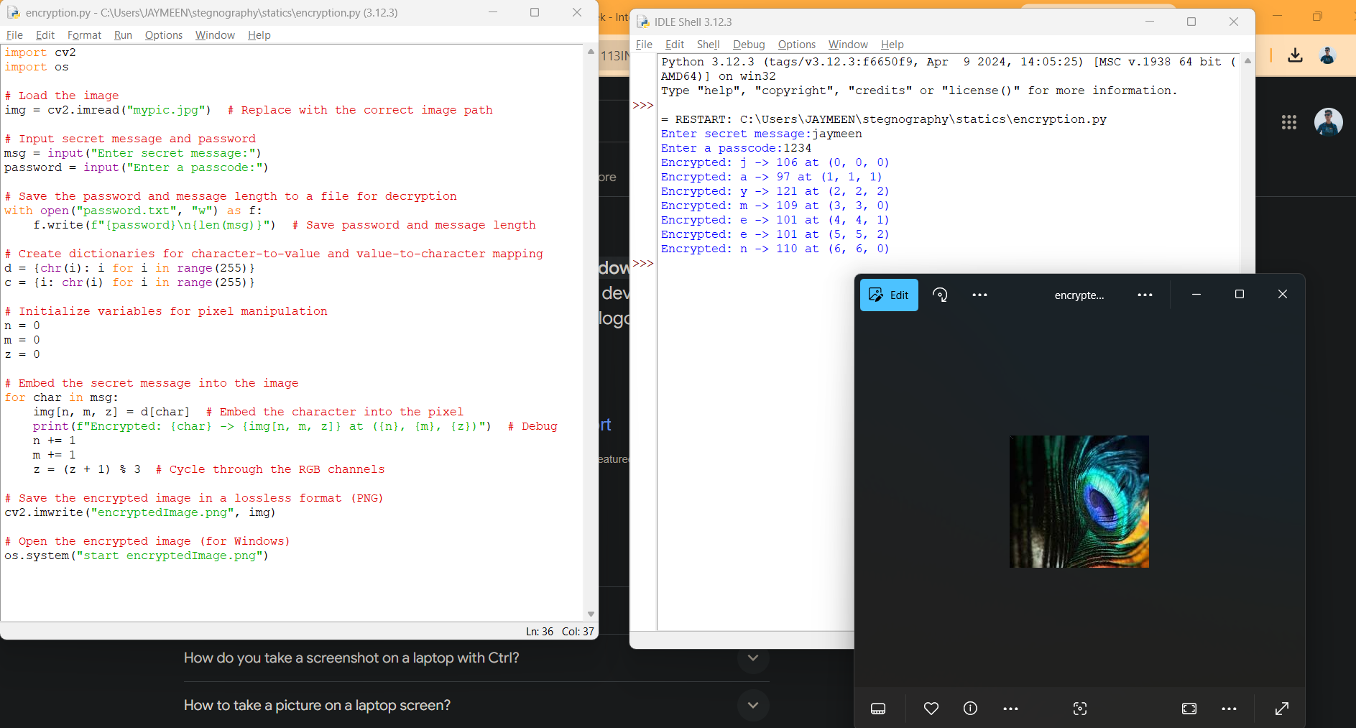
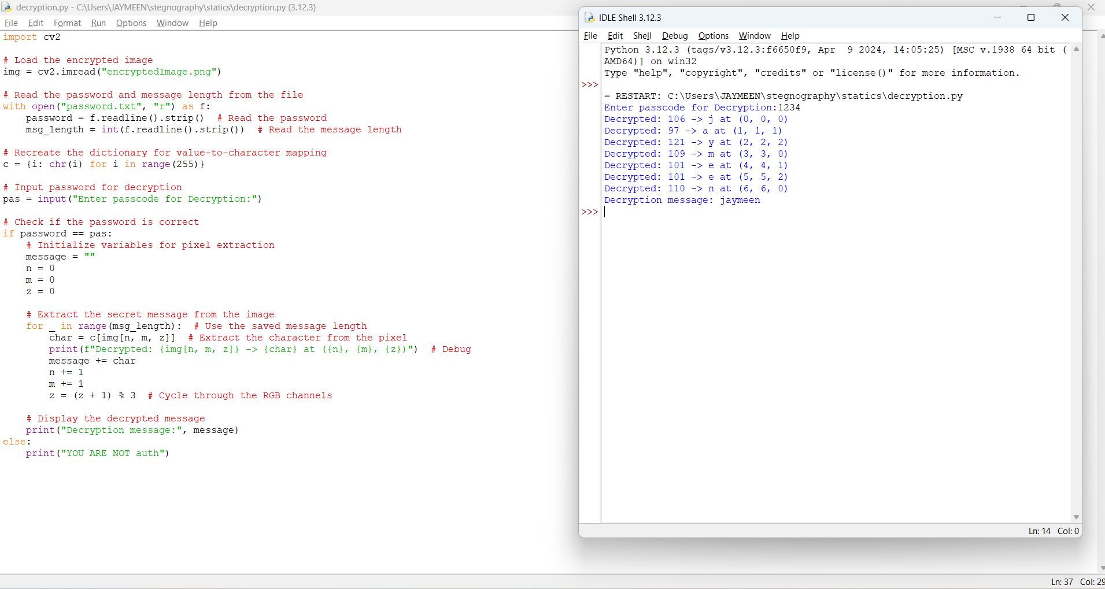
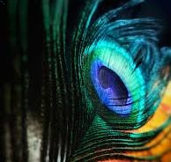
Results

Slide 8
Conclusion
This project successfully addresses the need for secure and undetectable communication by implementing a steganography system that hides secret messages within images. Using Python for encryption and decryption, the system ensures that sensitive information remains confidential and accessible only to authorized users with the correct password. By embedding data in images and retrieving it seamlessly, the project demonstrates a practical and effective solution for secure communication in today's digital world. This approach not only enhances privacy but also provides a simple yet powerful tool for individuals, businesses, and organizations to protect their data.

Slide 9
GitHub Link
https://github.com/ethicalknight/python-basssed-steganography-project.git

Slide 10
THANK YOU

